Slide 1
Lecture
PROBABILITY DISTRIBUTION OF DISCRETE RANDOM VARIABLES
Notes:
Warm up: Tell students to perform the following divisions:
81/3 = 27
1112/4=278
563/8=70.375
6489/6=1081.5

Slide 2
5.1 Random Variable
A random variable is a variable whose value is determined by the outcome of a random experiment. A random variable can be discrete or continuous.

Slide 3
5.1.1 Discrete Random Variable
A discrete random variable can be defined as a type of variable whose value depends on the numerical outcomes of a certain random event.
Always whole numbers, which easily to count.
no. of vehicles
Houses
fish caught
Complaints
customers
no. of heads obtained in tossing a coin twice.

Slide 4
5.1.2 Continuous Random Variable
A random variable whose values are not countable is called a continuous random variable.
A continuous random variable can assume any value over an interval.
height or weight of a person
the time taken to complete an assignment
the price of a house.

Slide 5
Example 5-1
Find the random variable for the following and list all the possible outcome.
The sum of the scores when two ordinary dice are thrown.
The number of tails obtained when three fair coins are tossed.

Slide 6
Example 5-1
The sum of the scores when two ordinary dice are thrown
 | 1 | 2 | 3 | 4 | 5 | 6
1 | 2 | 3 | 4 | 5 | 6 | 7
2 | 3 | 4 | 5 | 6 | 7 | 8
3 | 4 | 5 | 6 | 7 | 8 | 9
4 | 5 | 6 | 7 | 8 | 9 | 10
5 | 6 | 7 | 8 | 9 | 10 | 11
6 | 7 | 8 | 9 | 10 | 11 | 12
Sum={2,3,4,5,6,7,8,9,10,11,12}

Slide 7
Example 5-1
The number of tails obtained when three fair coins are tossed
S={HHH,HHT,HTH,HTT,THH,THT,TTH,TTT}
X={0,1,2,3}

Slide 8
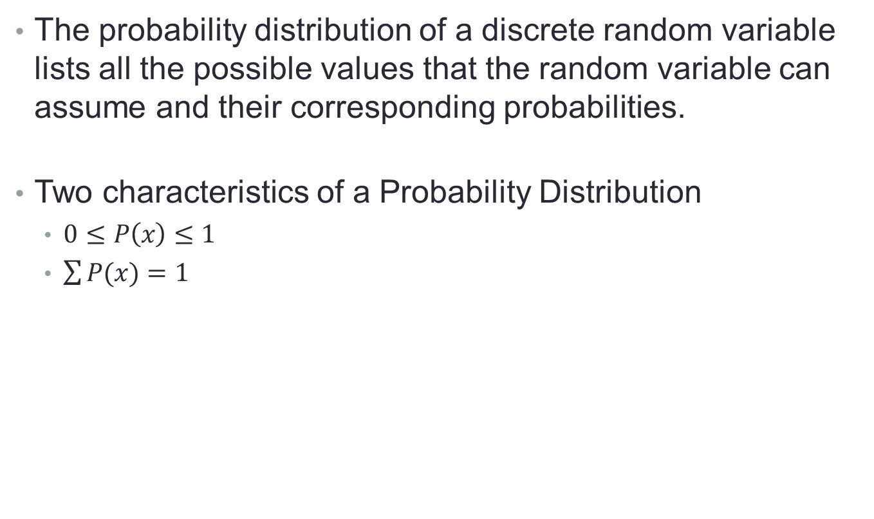
5.2 Probability Distribution of Discrete Random Variable
The probability distribution of a discrete random variable lists all the possible values that the random variable can assume and their corresponding probabilities.
Two characteristics of a Probability Distribution
$0≤P\left(x\right)≤1$
$\sum{P(x)}=1$

Slide 9
Frequency Distribution Table
 | x | Frequency (f)
 | 2 | 1
 | 3 | 2
 | 4
 | 5
 | 6
 | 7
 | 8
 | 9
 | 10
 | 11
 | 12
Total |  | 36

Slide 10
Probability Distribution Table The sum of the scores when two ordinary dice are thrown
 | x | P(x)
 | 2 | 1/36
 | 3 | 2/36
 | 4 | 3/36
 | 5 | 4/36
 | 6 | 5/36
 | 7 | 6/36
 | 8 | 5/36
 | 9 | 4/36
 | 10 | 3/36
 | 11 | 2/36
 | 12 | 1/36
Total |  | 36/36=1

Slide 11
Probability Distribution Table The number of tails obtained when three fair coins are tossed
 | x | P(x)
 | 0 | 1/8
 | 1 | 3/8
 | 2 | 3/8
 | 3 | 1/8
Total |  | 8/8=1

Slide 12
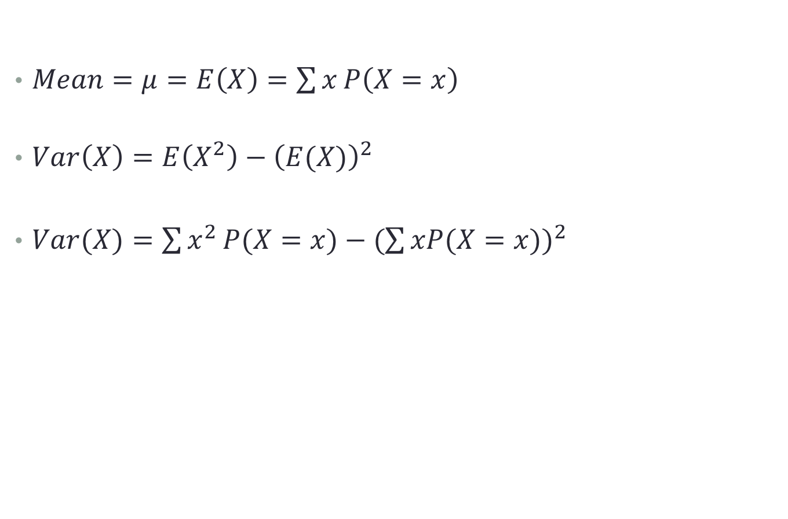
5.3 Mean and Variance of a Discrete Random Variable
$Mean=μ=E\left(X\right)=\sum{x}P\left(X=x\right)$
$Var\left(X\right)=E\left(X^{2}\right)−{\left(E(X)\right)}^{2}$
$Var(X)=\sum{x^{2}}P(X=x)−{(\sum{xP(X=x)})}^{2}$

Slide 13
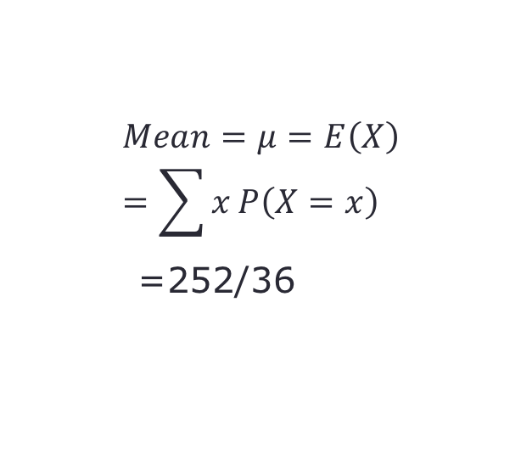
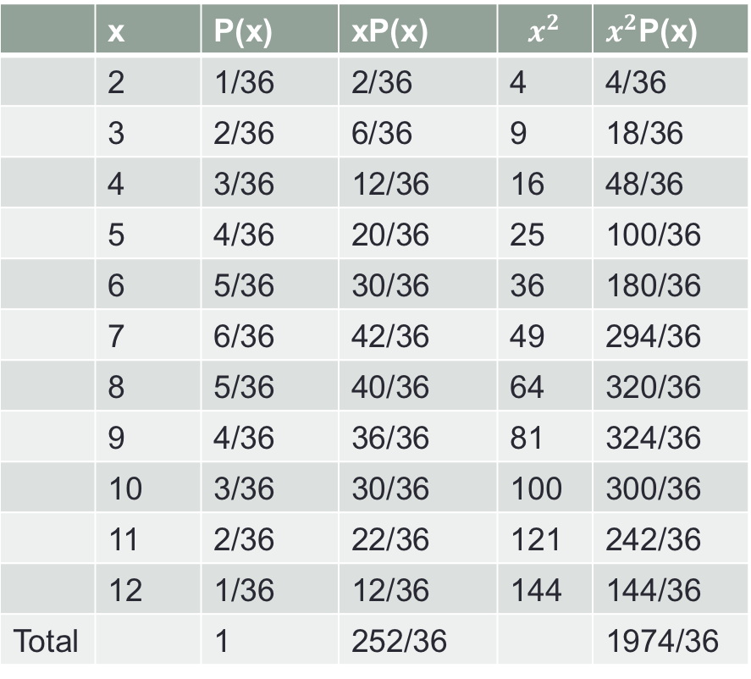

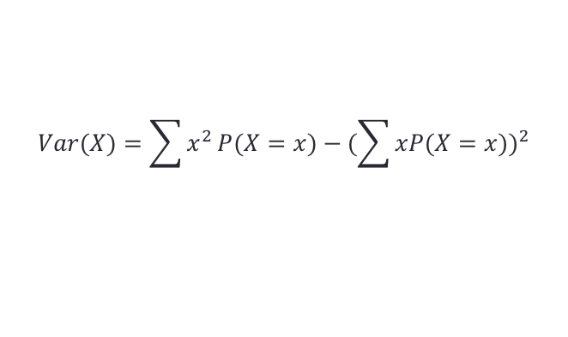

Example 5-2
Find the mean and variance for Example 5-1.
 | x | P(x) | xP(x) | $$x^{2}$$ | $x^{2}$P(x)
 | 2 | 1/36 | 2/36 | 4 | 4/36
 | 3 | 2/36 | 6/36 | 9 | 18/36
 | 4 | 3/36 | 12/36 | 16 | 48/36
 | 5 | 4/36 | 20/36 | 25 | 100/36
 | 6 | 5/36 | 30/36 | 36 | 180/36
 | 7 | 6/36 | 42/36 | 49 | 294/36
 | 8 | 5/36 | 40/36 | 64 | 320/36
 | 9 | 4/36 | 36/36 | 81 | 324/36
 | 10 | 3/36 | 30/36 | 100 | 300/36
 | 11 | 2/36 | 22/36 | 121 | 242/36
 | 12 | 1/36 | 12/36 | 144 | 144/36
Total |  | 1 | 252/36 |  | 1974/36
$$Mean=μ=E\left(X\right)=\sum{x}P\left(X=x\right)$$
=252/36
$$Var\left(X\right)=E\left(X^{2}\right)−{\left(E(X)\right)}^{2}$$
$$Var(X)=\sum{x^{2}}P(X=x)−{(\sum{xP(X=x)})}^{2}$$
=$\frac{1974}{36}−{\left(\frac{252}{36}\right)}^{2}$

Slide 14
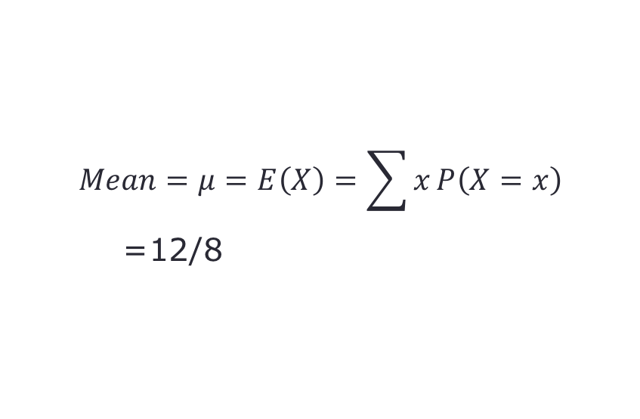
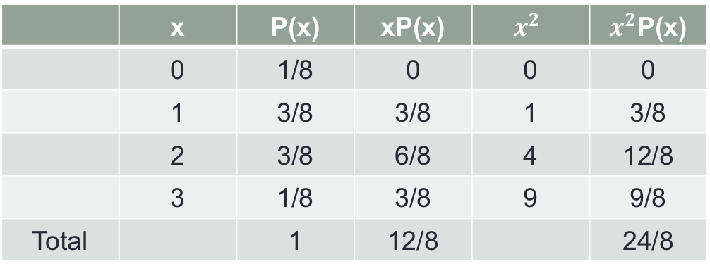


The number of tails obtained when three fair coins are tossed.
 | x | P(x) | xP(x) | $$x^{2}$$ | $x^{2}$P(x)
 | 0 | 1/8 | 0 | 0 | 0
 | 1 | 3/8 | 3/8 | 1 | 3/8
 | 2 | 3/8 | 6/8 | 4 | 12/8
 | 3 | 1/8 | 3/8 | 9 | 9/8
Total |  | 1 | 12/8 |  | 24/8
$$Mean=μ=E\left(X\right)=\sum{x}P\left(X=x\right)$$
=12/8
$$Var(X)=\sum{x^{2}}P(X=x)−{(\sum{xP(X=x)})}^{2}$$
=$\frac{24}{8}−{\left(\frac{12}{8}\right)}^{2}$

Slide 15

Example 5-3
In the table below, $x$ represents the number of breakdowns for a machine during a given week, and $P(x)$ is the probability of the corresponding value of $x$. Find the mean number of breakdowns per week for this machine
x | P(x)
0 | .15
1 | .20
2 | .35
3 | .30

Slide 16
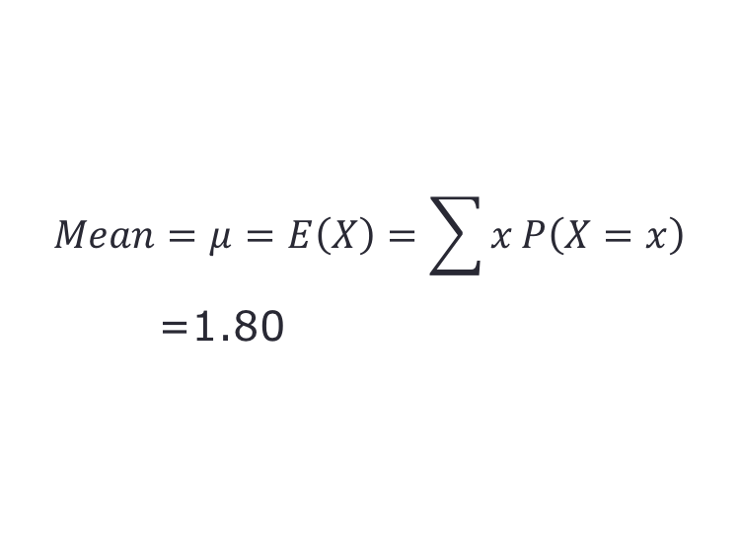
Example 5-3
x | P(x) | xP(x)
0 | 0.15 | 0
1 | 0.20 | 0.20
2 | 0.35 | 0.70
3 | 0.30 | 0.90
Total | 1.00 | 1.80
$$Mean=μ=E\left(X\right)=\sum{x}P\left(X=x\right)$$
=1.80

Slide 17
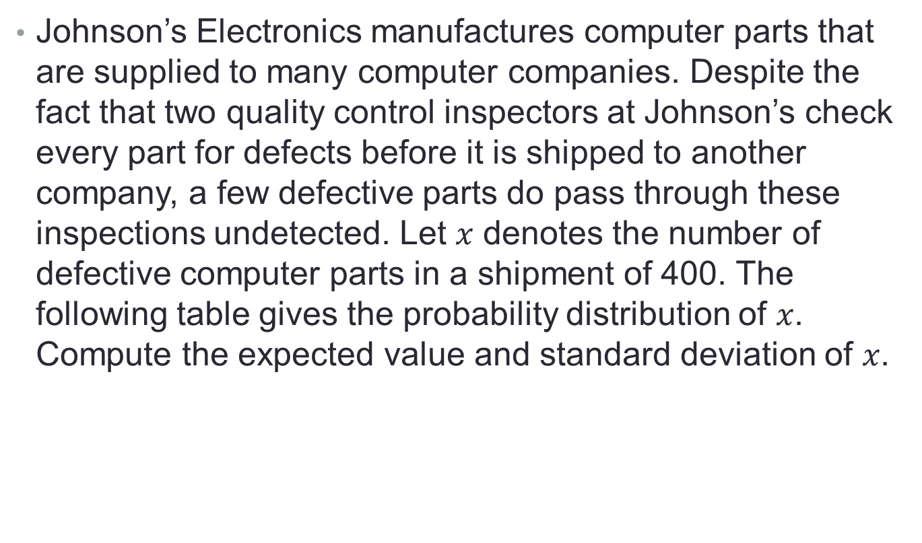
Example 5-4
Johnson’s Electronics manufactures computer parts that are supplied to many computer companies. Despite the fact that two quality control inspectors at Johnson’s check every part for defects before it is shipped to another company, a few defective parts do pass through these inspections undetected. Let $x$ denotes the number of defective computer parts in a shipment of 400. The following table gives the probability distribution of $x$. Compute the expected value and standard deviation of $x$.
x | 0 | 1 | 2 | 3 | 4 | 5
P(x) | .02 | .2 | .3 | .3 | .1 | .08

Slide 18
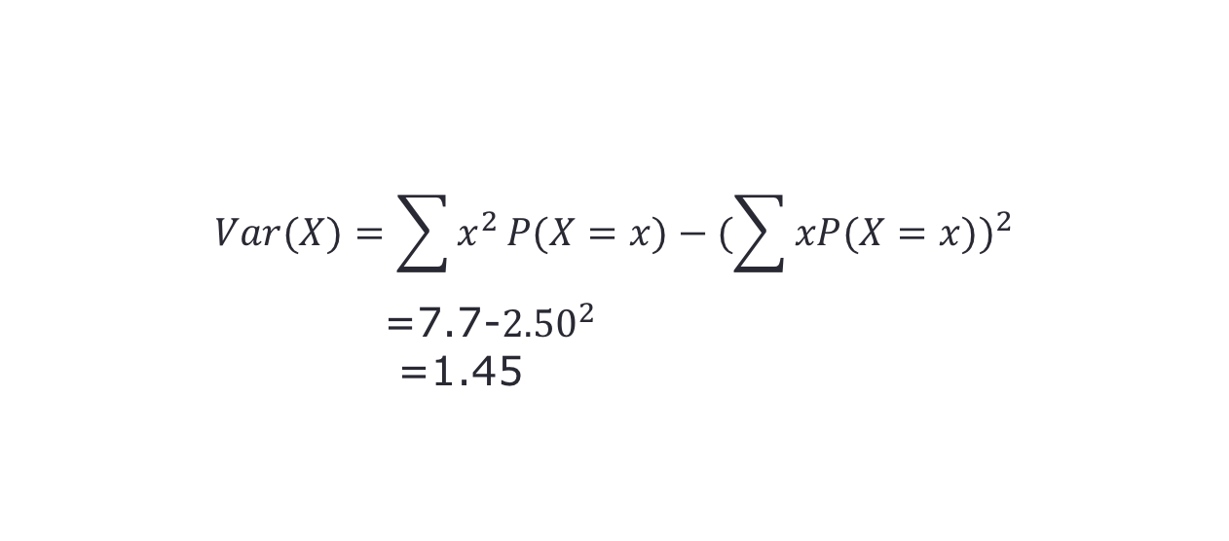
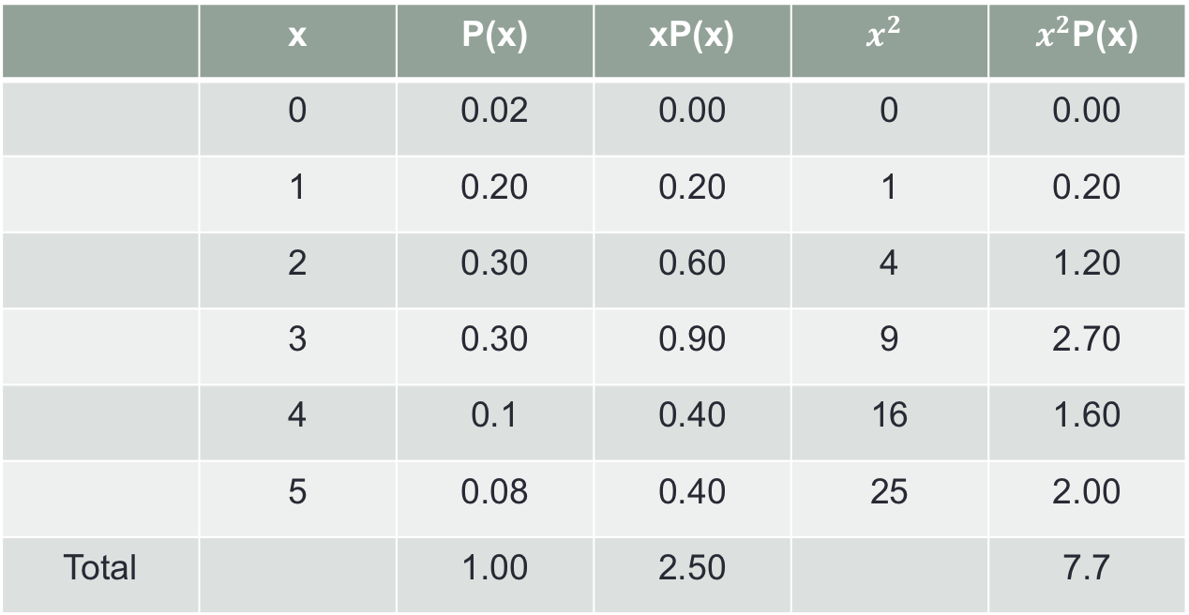
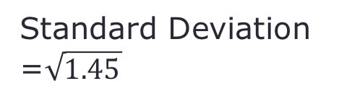
Example 5-4
 | x | P(x) | xP(x) | $$x^{2}$$ | $x^{2}$P(x)
 | 0 | 0.02 | 0.00 | 0 | 0.00
 | 1 | 0.20 | 0.20 | 1 | 0.20
 | 2 | 0.30 | 0.60 | 4 | 1.20
 | 3 | 0.30 | 0.90 | 9 | 2.70
 | 4 | 0.1 | 0.40 | 16 | 1.60
 | 5 | 0.08 | 0.40 | 25 | 2.00
Total |  | 1.00 | 2.50 |  | 7.7
expected value = mean =2.50
$$Var(X)=\sum{x^{2}}P(X=x)−{(\sum{xP(X=x)})}^{2}$$
=7.7-${2.50}^{2}$
=1.45
Standard Deviation =$\sqrt{1.45}$

Slide 19
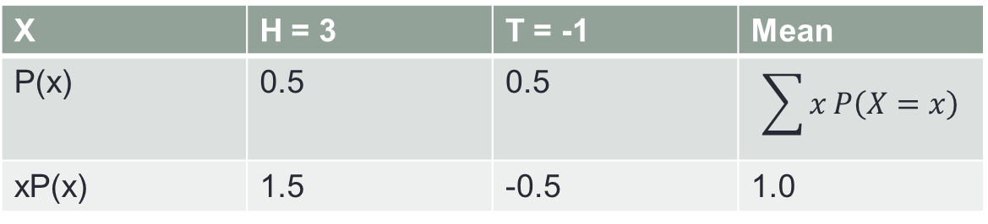
Which one would you be most likely to play
Consider the following three games.
Which one would you be most likely to play?
Which one would you be least likely to play?
Explain your answer mathematically.
Game I:
You toss a fair coin once. If a head appears you receive $3, but if a tail appears you have to pay $1.
X | H = 3 | T = -1 | Mean
P(x) | 0.5 | 0.5 | $$\sum{x}P\left(X=x\right)$$
xP(x) | 1.5 | -0.5 | 1.0

Slide 20
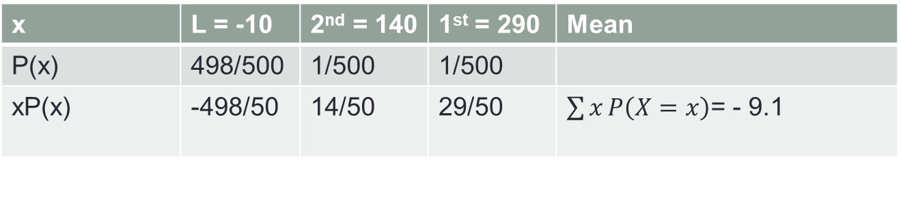
Which one would you be most likely to play
Game II:
You buy a single ticket for $10 for a raffle that has a total of 500 tickets. Two tickets are chosen without replacement from the 500. The holder of the first ticket selected receives $300, and the holder of the second ticket selected receives $150.
x | L = -10 | 2nd = 140 | 1st = 290 | Mean
P(x) | 498/500 | 1/500 | 1/500
xP(x) | -498/50 | 14/50 | 29/50 | $\sum{x}P\left(X=x\right)$= - 9.1

Slide 21
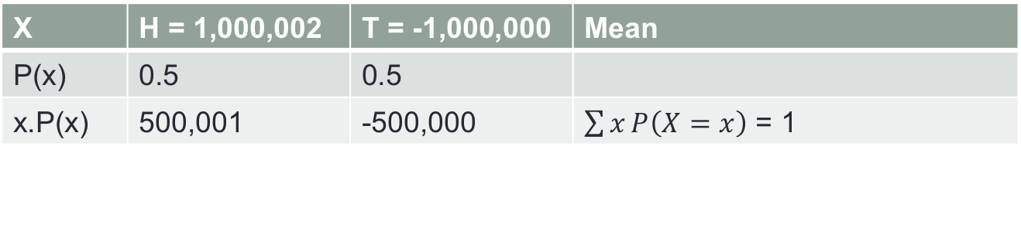
Which one would you be most likely to play
Game III:
You toss a fair coin once. If a head appears you receive $1,000,002, but if a tail appears you have to pay $1,000,000
X | H = 1,000,002 | T = -1,000,000 | Mean
P(x) | 0.5 | 0.5
x.P(x) | 500,001 | -500,000 | $\sum{x}P\left(X=x\right)$ = 1

Slide 22
THANK YOU

